Slide 1
Sex and Gender Complexity in Scientific Research: Ethical, Political, and Epistemological
Catherine Clune-Taylor, BMSc, PhD
Assistant Professor, Program in Gender and Sexuality Studies, Princeton University
July 17, 2024
Slides available at www.clune-taylor.com/upcoming-presentations
Notes:
The title slide looks stellar with titles that span one to three lines.

Slide 2
Overview
Science as Ethical, Political, and Epistemological
Sex and Gender Complexity in Scientific Research
Case Study: Intersex
Notes:
The standard content slide accommodates two line titles and a large body of text.

Slide 3
Science as Ethical, Political, and Epistemological
Notes:
An optional divider slide can be used to organize your presentations into sections, change directions, or prompt your audience.

Slide 4
Science and Ethics
Research Ethics
Autonomy, Study Benefits/Risks, Clinical Equipoise, Subject Diversity (e.g., heart attacks in women).
Science and Values
Justice
Bioethics (Autonomy, Beneficence, Non-maleficence, Justice)
Biomedical Science as a Good
The aims of biomedical science are goods (e.g., improving the mortality and morbidity of diabetics is a good).
Thus, there is an ethical imperative to do biomedical research well.
Notes:
The standard content slide accommodates two line titles and a large body of text.

Slide 5
Science as Political
Science is political insofar as it shapes policy.
The relationship between science and policy is complex, and often political (in the more popular sense of the term).
Examples:
Covid-19 Pandemic Response.
Covid-19Vaccination Program.
Chevron Ruling.
Points to the issue of Epistemic Authority
Photo by Yohann LIBOT on Unsplash
Notes:
Photo by Yohann LIBOT on Unsplash

Slide 6
Science and Epistemology
Science is the most efficient method for producing reliable knowledge about the natural and unnatural world.
It can be done in better and worse ways such that we distinguish between different levels or quality of evidence.
Sample Epistemic Values:
Internal Consistency
Predictive Competency
Predicative Accuracy
Explanatory Power
Scope
External Consistency
Replicability
The reasons why excluding women from studies on heart disease is a problem then, are ethical, political, and epistemological.
Notes:
Photo by Yohann LIBOT on Unsplash

Slide 7
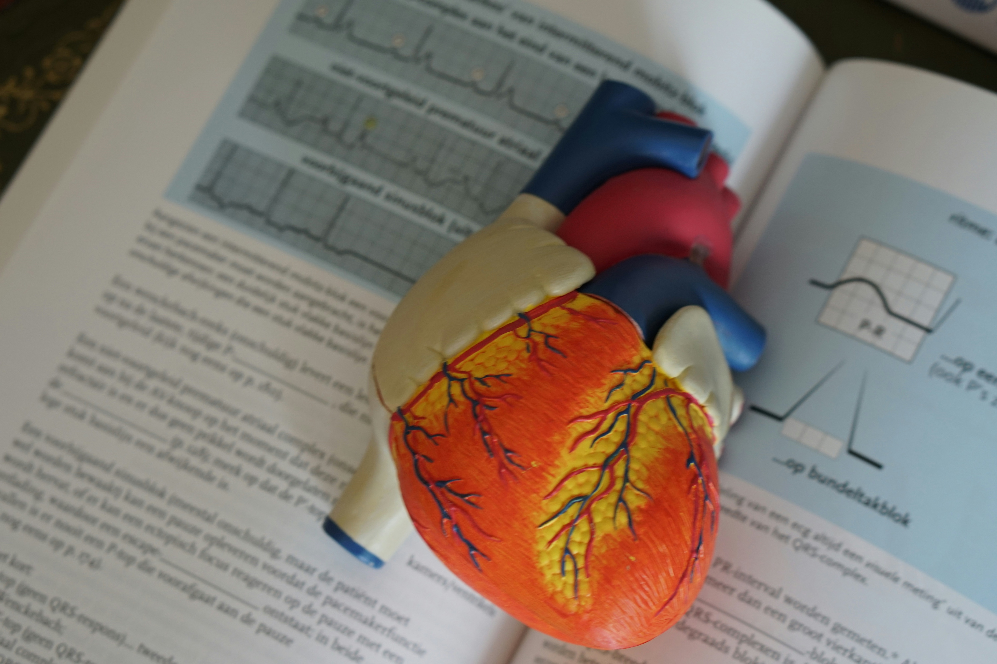
Women and Heart Attack
Ethical → Unjust, compromises the ethical imperatives.
Political →Worse policies, poorer training.
Epistemological → Worse science, less accurate, less representative, less generalizable, introduces error (Douglas 2009)
However, what do we mean when we say “women”? If we are not specific and accurate, further research will not resolve these ethical, political, and epistemological concerns.
Photo by Robina Weermeijer on Unsplash
Notes:
Photo by Robina Weermeijer on Unsplash

Slide 8
Sex and Gender Complexity in Scientific Research
Notes:
An optional divider slide can be used to organize your presentations into sections, change directions, or prompt your audience.

Slide 9
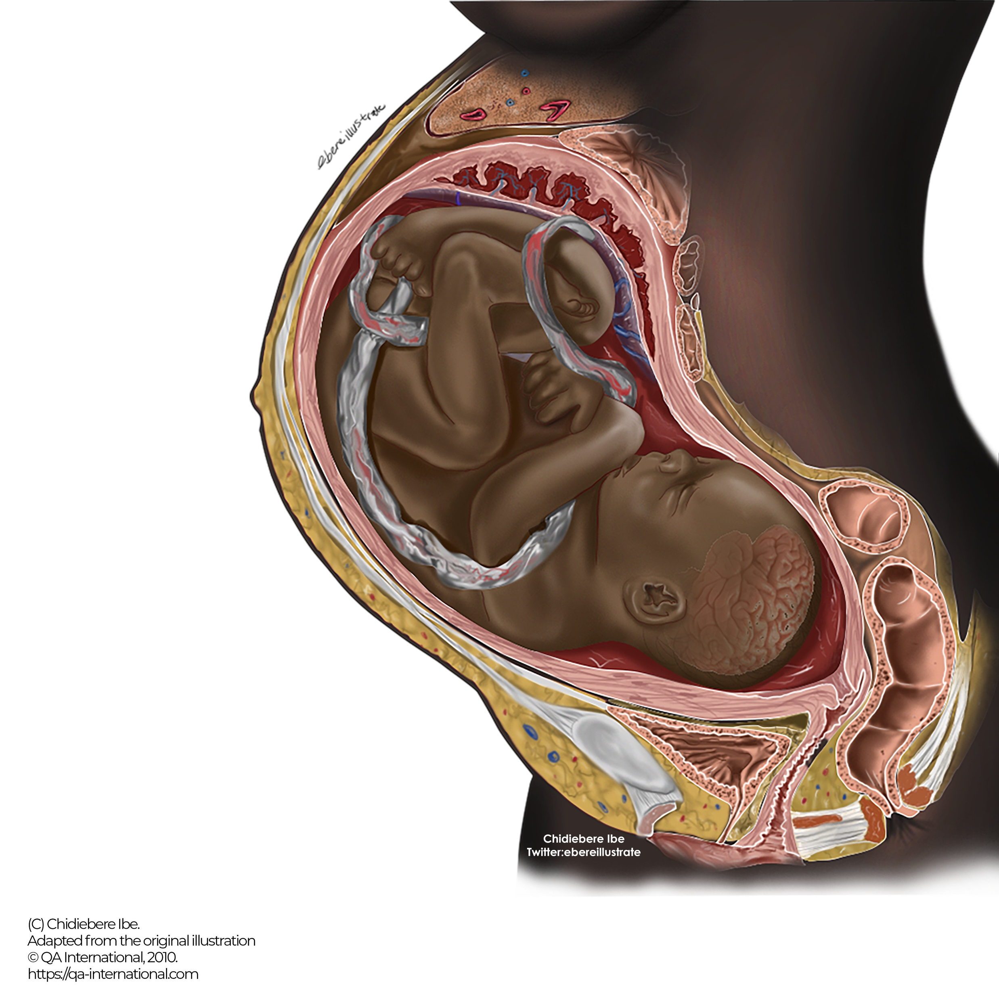
Sex (and Gender) are Complex
….and thus, so is accounting for them in scientific research.
Sex: external genitalia, internal reproductive structures, gonads, chromosomes, hormones (and brain structures?).
Is it Sex and/or Gender?
Consider Fausto-Sterling (2005) on Osteoporosis
Treated as sex-linked but tracks racialized norms of gender.
Consider epigenetic research on Black maternal mortality and morbidity in the United States.
Racialized and gendered environment leads to identifiable genomic changes
Image to Come
Notes:
The Black Fetus Illustration by Chidiebere Ibe. Adapted from the original illustration © QA International, 2010. https://qa-international.com This image has been widely identified as the first anatomical illustration of a fetus and pregnant human featuring Black bodies.

Slide 10
Case Study: Intersex
Notes:
An optional divider slide can be used to organize your presentations into sections, change directions, or prompt your audience.

Slide 11
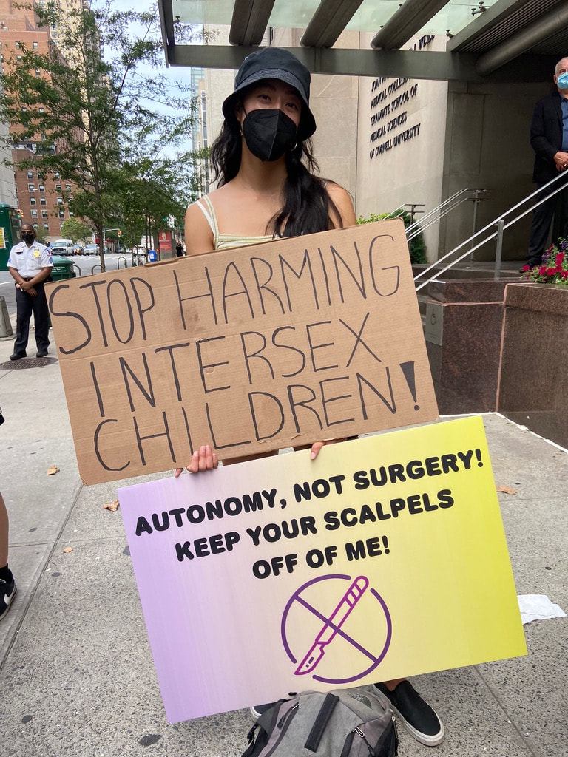
Intersex Exclusion and Inclusion in Research
Biomedical research generally excludes intersex subjects for being 1) categorically complex and 2) rare.
Sex is rarely checked.
Less rare than we think (Hannah-Shmouni et al., 2017).
Exclusion raises important ethical, political, and epistemological issues for research.
Intersex people are nonetheless extensively studied.
Evidence to support surgical sex assignment in infants.
Increase knowledge about abnormal and normal sex/gender development.
This research rarely aims at improving the health outcomes of those with intersex conditions.
Image to Come
A protestor holds #EndIntersexSurgery signs at the NYC protest of Dr. Dix Poppas. Photo by Casey Orozco-Poore.
Notes:
A protestor holds #EndIntersexSurgery signs at the NYC protest of Dr. Dix Poppas. Photo by Casey Orozco-Poore. Available at Intersex Justice Project - Press

Slide 12
Any Questions?
Notes:
If you have any questions, contact the NHGRI Office of Communications at nhgri_communications@nih.gov.

Slide 13
Bibliography
Douglas, Heather. 2009. Science, Policy, and the Value-Free Ideal. Pittsburgh, UNITED STATES: University of Pittsburgh Press.
Fausto-Sterling, Anne. 2008. “The Bare Bones of Race.” Social Studies of Science 38 (5,): 657–94.
Hannah-Shmouni, Fady, Rachel Morissette, Ninet Sinaii, Meredith Elman, Toni R Prezant, Wuyan Chen, Ann Pulver, and Deborah P Merke. 2017. “Revisiting the Prevalence of Nonclassic Congenital Adrenal Hyperplasia in US Ashkenazi Jews and Caucasians.” Genetics in Medicine 19 (11): 1276–79. https://doi.org/10.1038/gim.2017.46.
Sullivan, Shannon. 2013. “Inheriting Racist Disparities in Health.” Critical Philosophy of Race 1 (2): 190–218. https://doi.org/10.5325/critphilrace.1.2.0190.

